Slide 1
AI ADOPTION &
BUSINESS PERFORMANCE
ANALYSIS
Presented By
• Rudra Pratap Singh Rathore
• Techno NJR Institute of Technology

Slide 2
PROJECT OVERVIEW
Problem Statement
Organizations are increasingly adopting Artificial Intelligence to improve business performance. This project analyzes AI adoption trends from 2015–2025 to understand their impact on productivity, revenue, cost savings, automation, and AI maturity.
Objectives
✔ Evaluate AI adoption trends and business performance between 2015-2025.
✔ Perform thorough data cleaning, preprocessing, and outlier handling.
✔ Conduct detailed exploratory data analysis to identify industry trends.
✔ Analyze the operational impact of AI on productivity and cost savings.
✔ Provide data-driven strategic insights and actionable recommendations.

Slide 3
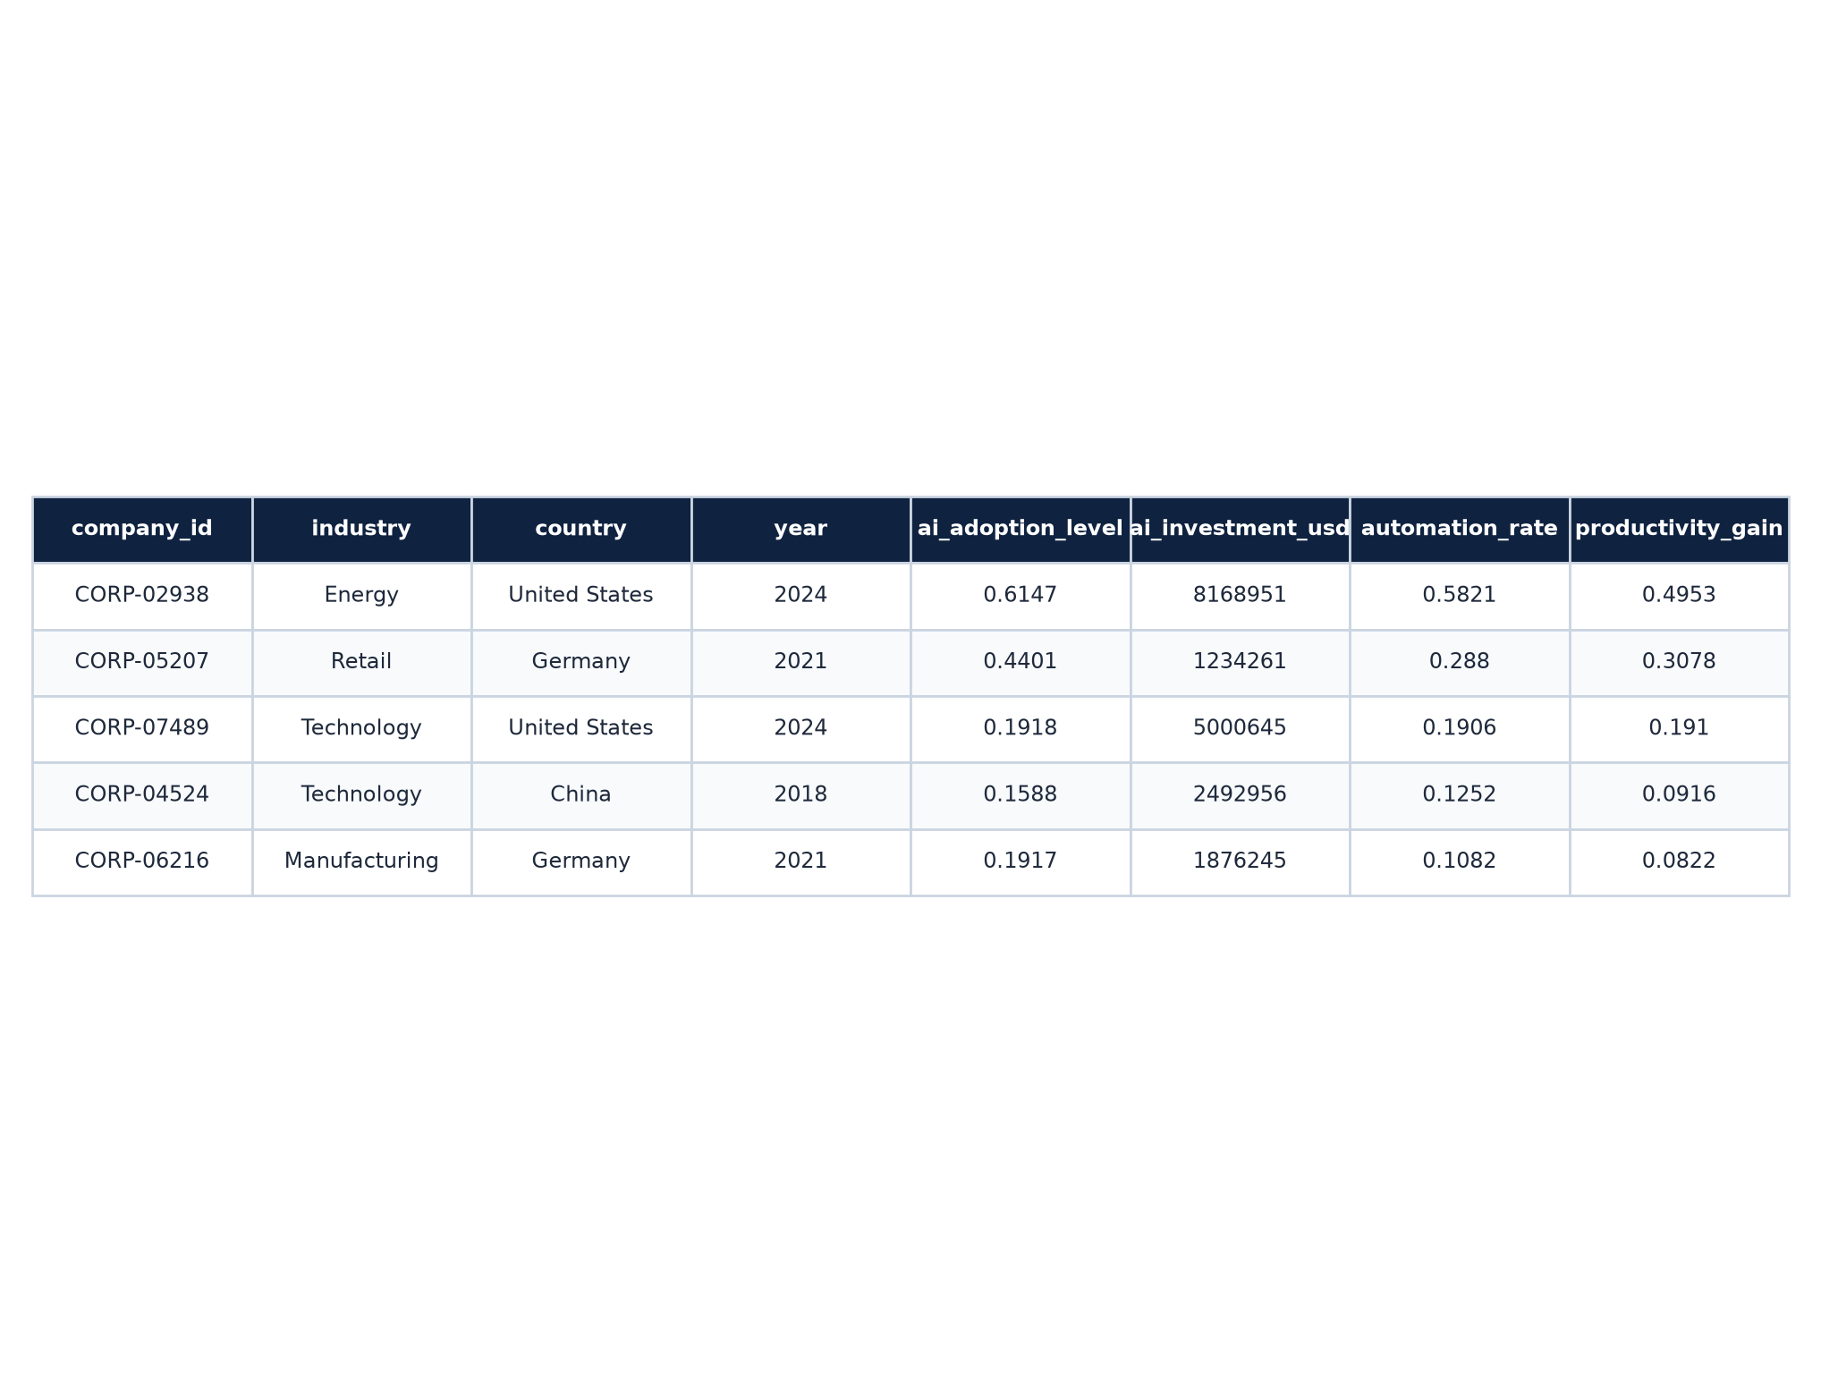
DATASET
DESCRIPTION
📊 Total Records: 104,845 rows
🏢 Companies: 8,000 unique corporate IDs
🏭 Industries: 10 distinct sectors
🌍 Countries: 15 unique nations
📅 Time Period: 2015 – 2025
📋 Features: 13 metrics tracked
Dataset Information

Slide 4
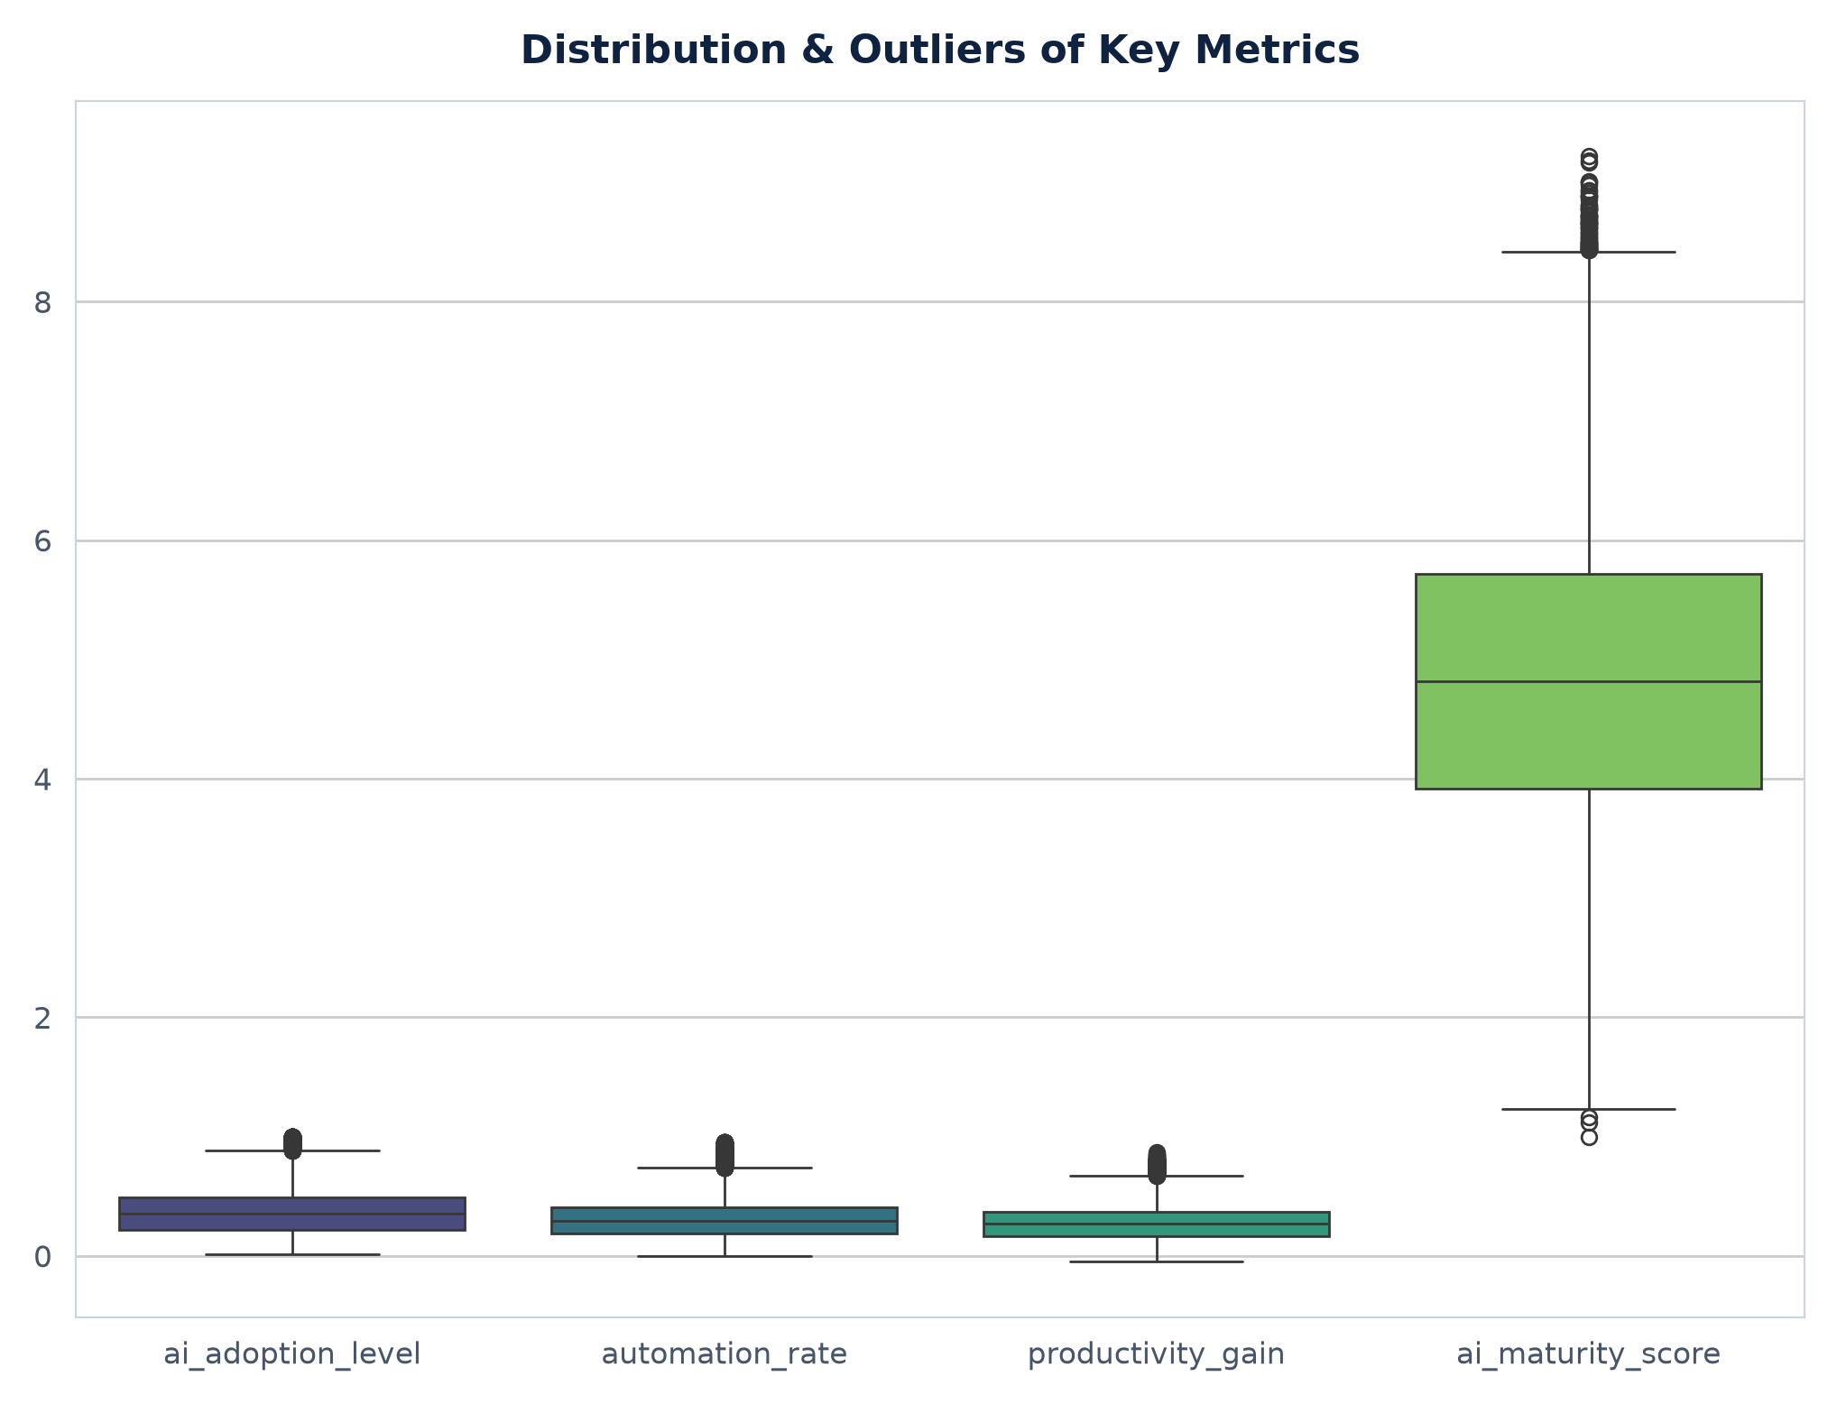
DATA CLEANING &
PREPROCESSING
Data Integrity Checks
✔ Missing Values → 0 verified
✔ Duplicate Rows → 0 verified
✔ Correct Data Types (Floats & Ints)
✔ Unique Categories Verified
✔ Outlier Detection & Business Retention

Slide 5
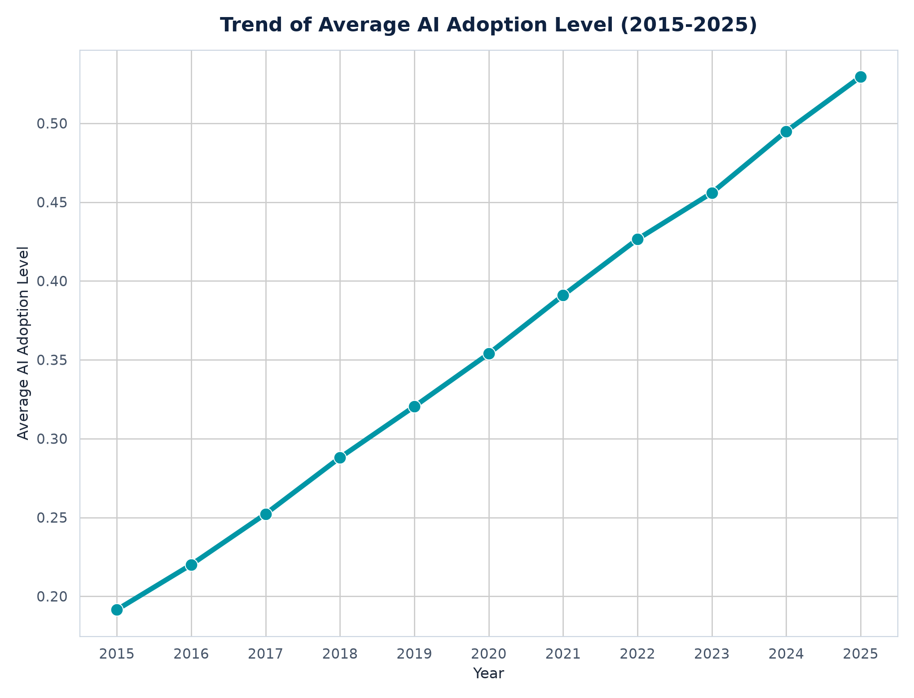
AI ADOPTION
TREND
Observation
AI adoption has consistently grew steadily over the decade, rising from an average adoption index of 0.19 in 2015 to 0.53 in 2025.
Business Insight This highlights the continuous integration of AI technologies across corporate workflows, shifting AI from an experimental project to a core operational capability.

Slide 6
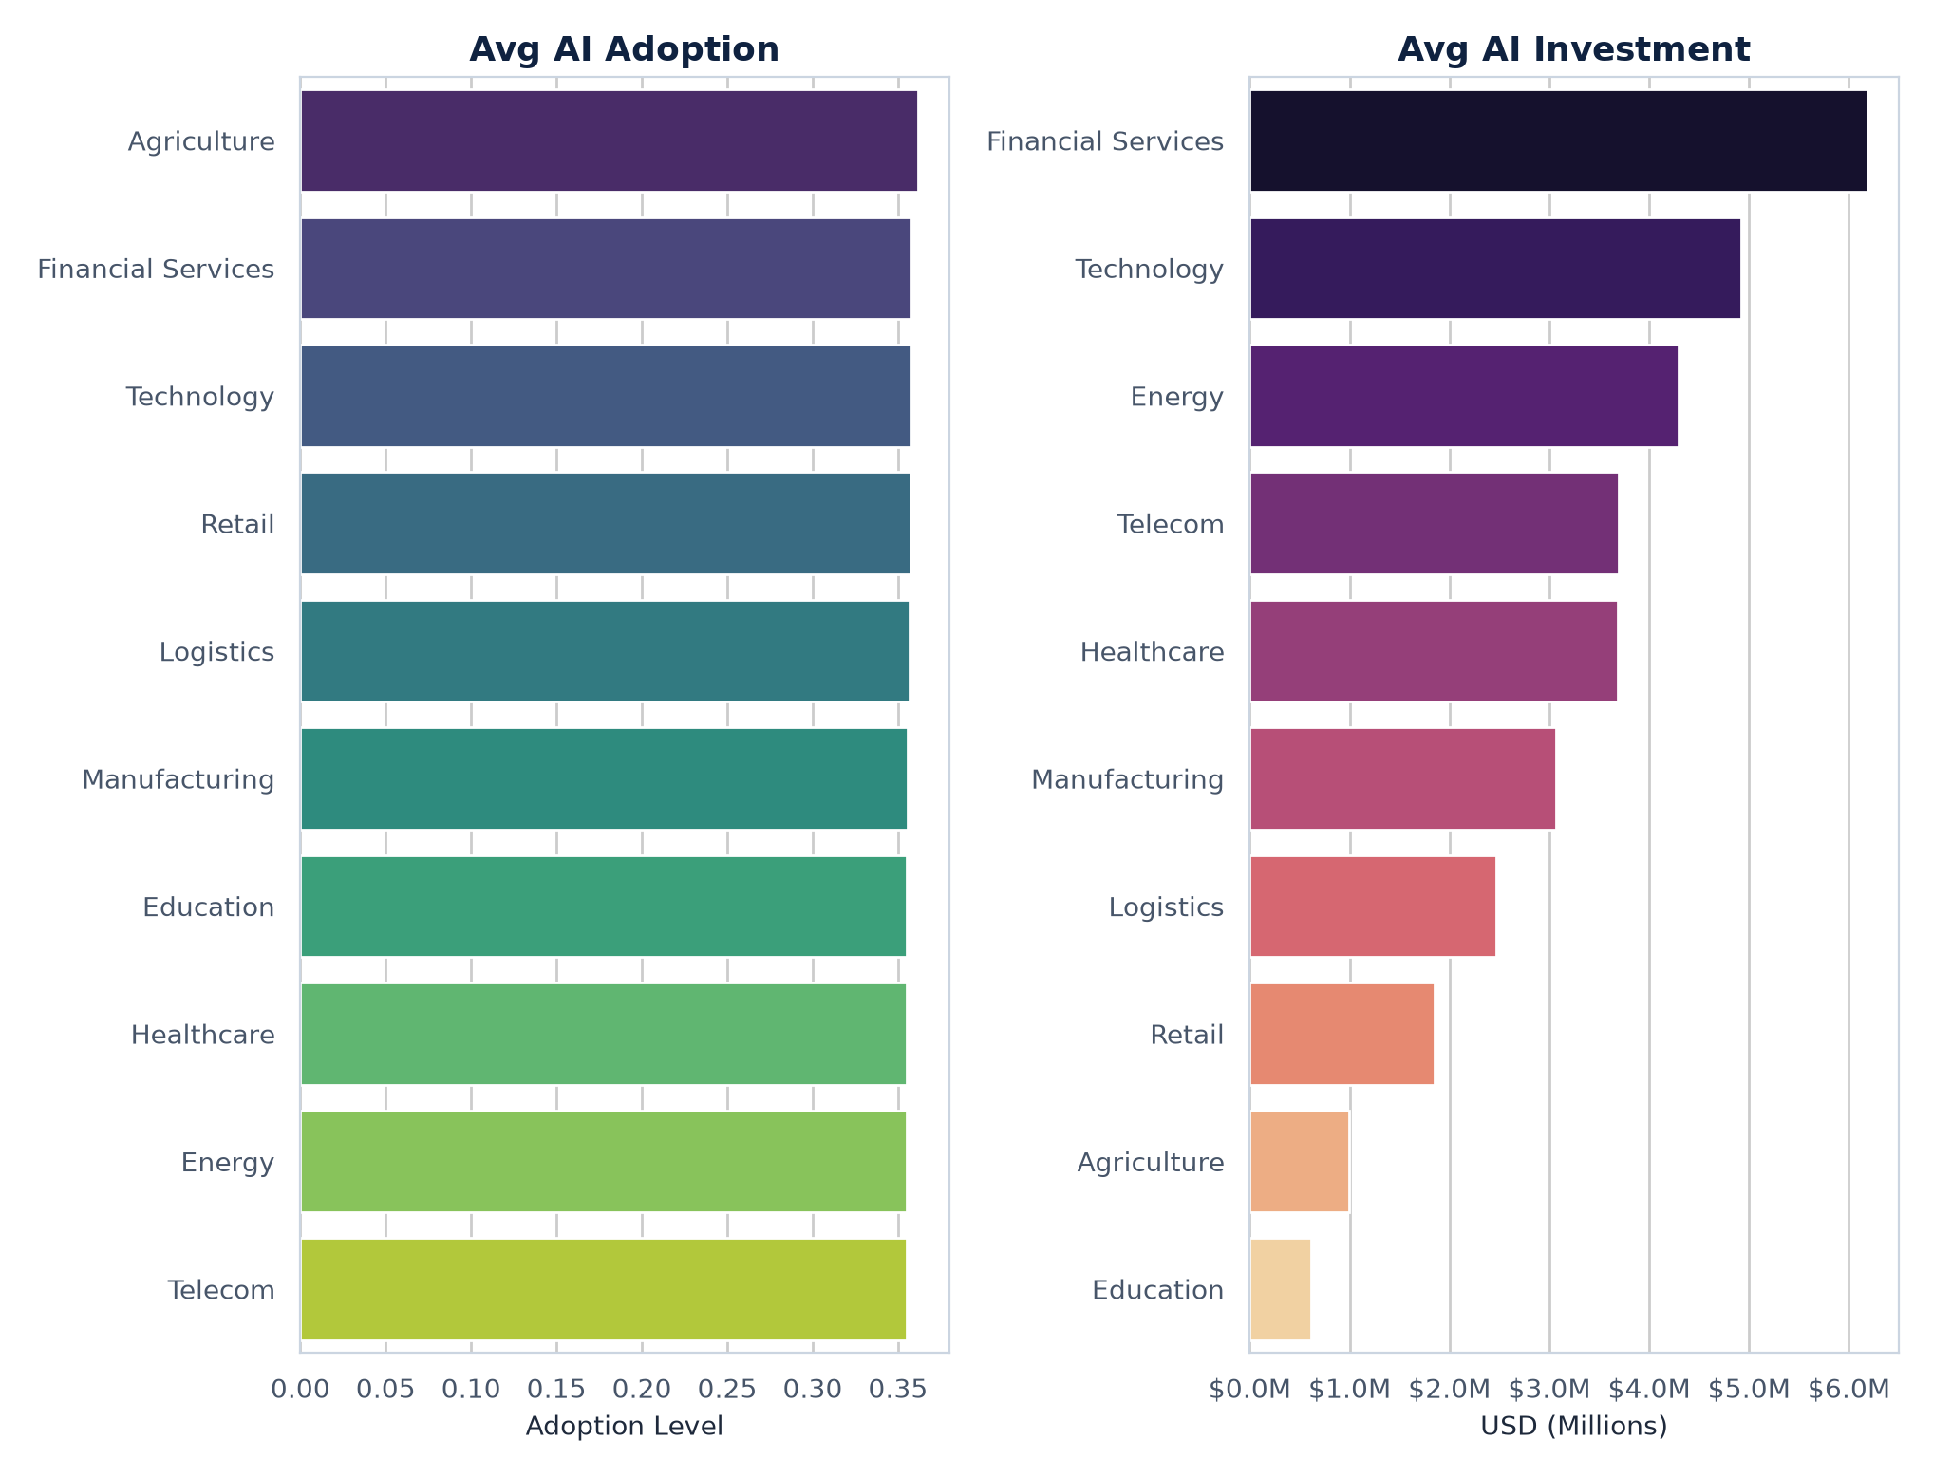
AI ADOPTION &
INVESTMENT
Observation
Average AI adoption level remains remarkably uniform across all 10 industry sectors (around 0.35-0.36 index level).
Business Insight However, financial backing diverges heavily. Financial Services invests the most in AI (average exceeding $6.19M), followed by Technology ($4.92M), while Education ranks last ($0.61M).

Slide 7
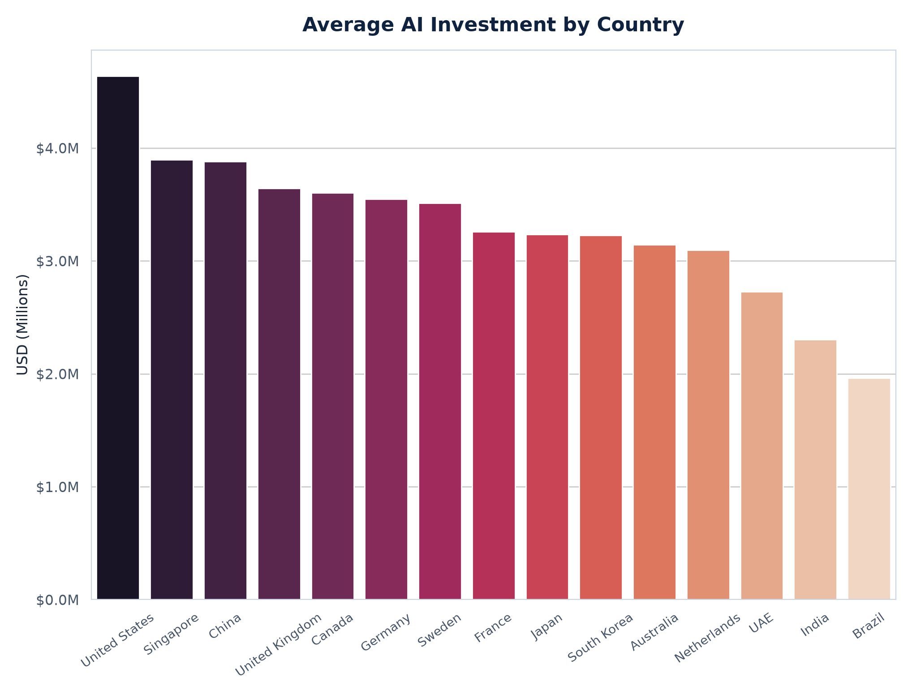
COUNTRY
ANALYSIS
Observation
The United States leads the average global corporate AI investment at $4.64 million, with Singapore ($3.89M) and China ($3.88M) ranking next.
Business Insight Brazil ($1.96M) and India ($2.33M) show lower average investment levels. These developing markets represent massive future scaling opportunities.

Slide 8
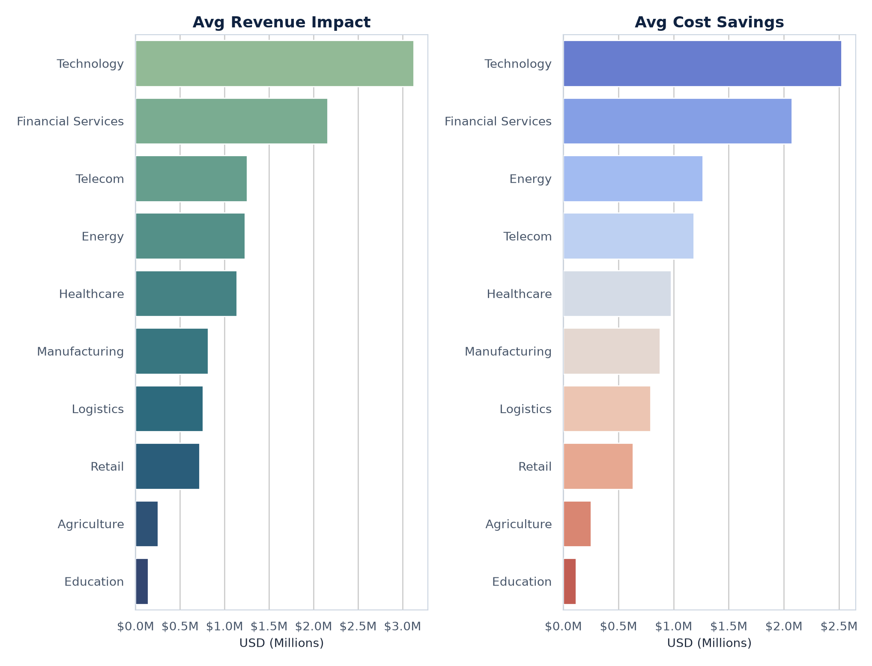
BUSINESS
PERFORMANCE
Observation
Technology achieves the highest average revenue impact ($3.13M) and cost savings ($2.52M). Financial Services follows as the second highest financial performer.
Business Insight Conversely, Education records the lowest average revenue impact ($0.14M) and cost savings ($0.11M), showing that returns are sector-dependent.

Slide 9
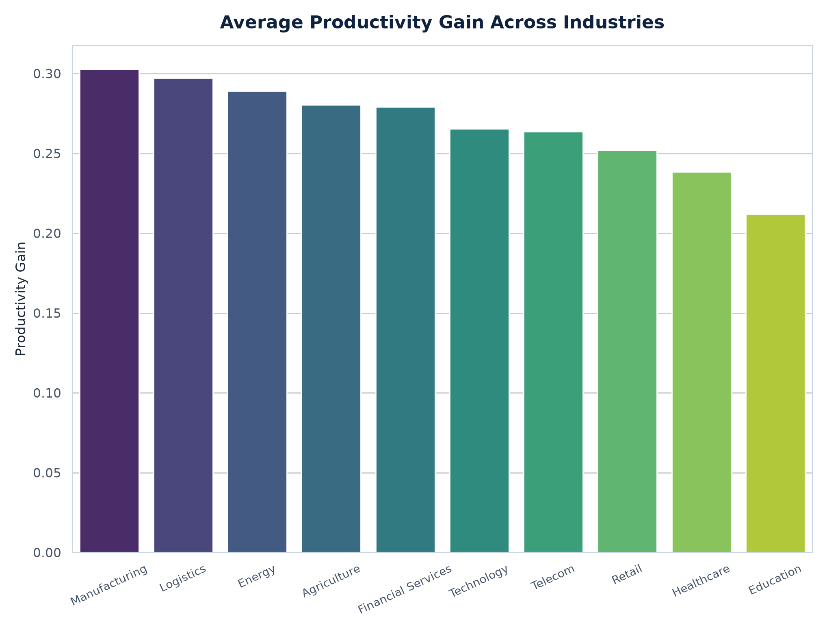
PRODUCTIVITY
ANALYSIS
Observation
Manufacturing and Logistics sectors record the highest average productivity gains (0.30 index gain), followed closely by Energy (0.29).
Business Insight Physical asset operations gain the most efficiency from AI process automation and logistical resource optimization.

Slide 10
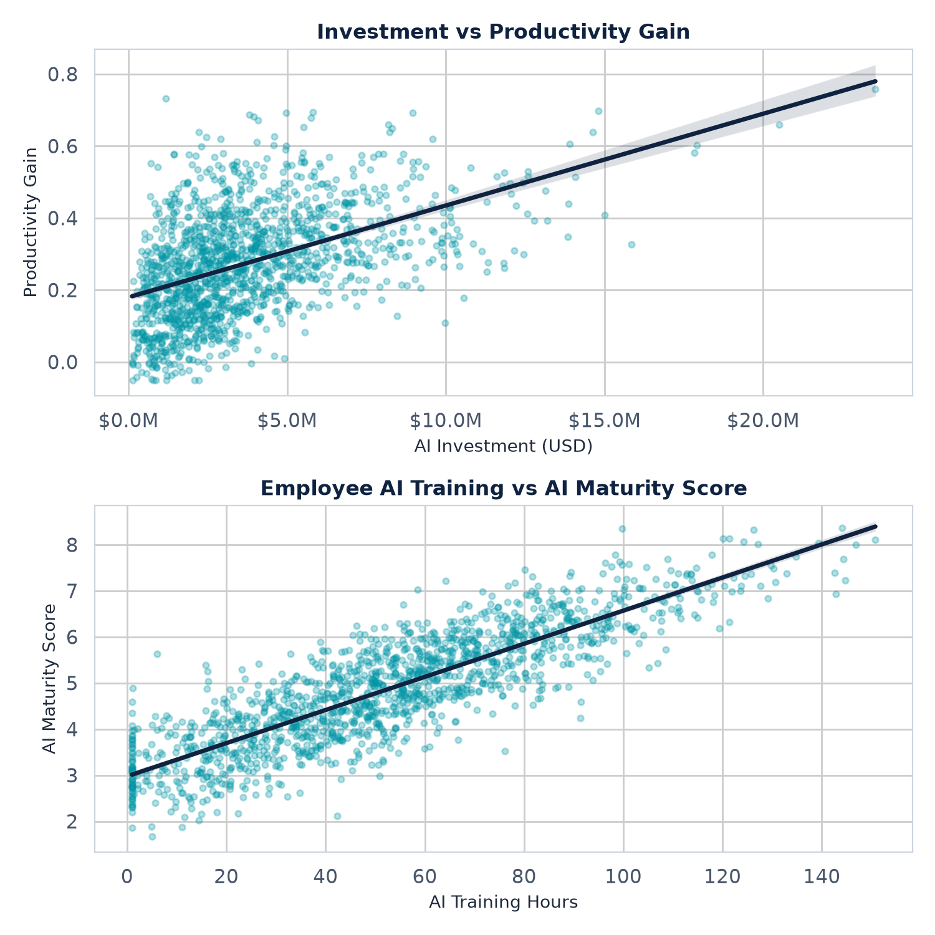
RELATIONSHIP
ANALYSIS
0.845
Correlation: Training vs AI Maturity
Key Relationships
• AI Investment correlates moderately with Productivity Gain, indicating budget alone is not the sole factor.
• Employee Training is a massive builder of capability, correlating extremely strongly (r = 0.845) with AI Maturity.
Highlight Insight:
Workforce capability is the single most influential driver of AI adoption maturity. Companies must prioritize employee training hours to convert AI technology acquisitions into mature, high-performing corporate assets.

Slide 11
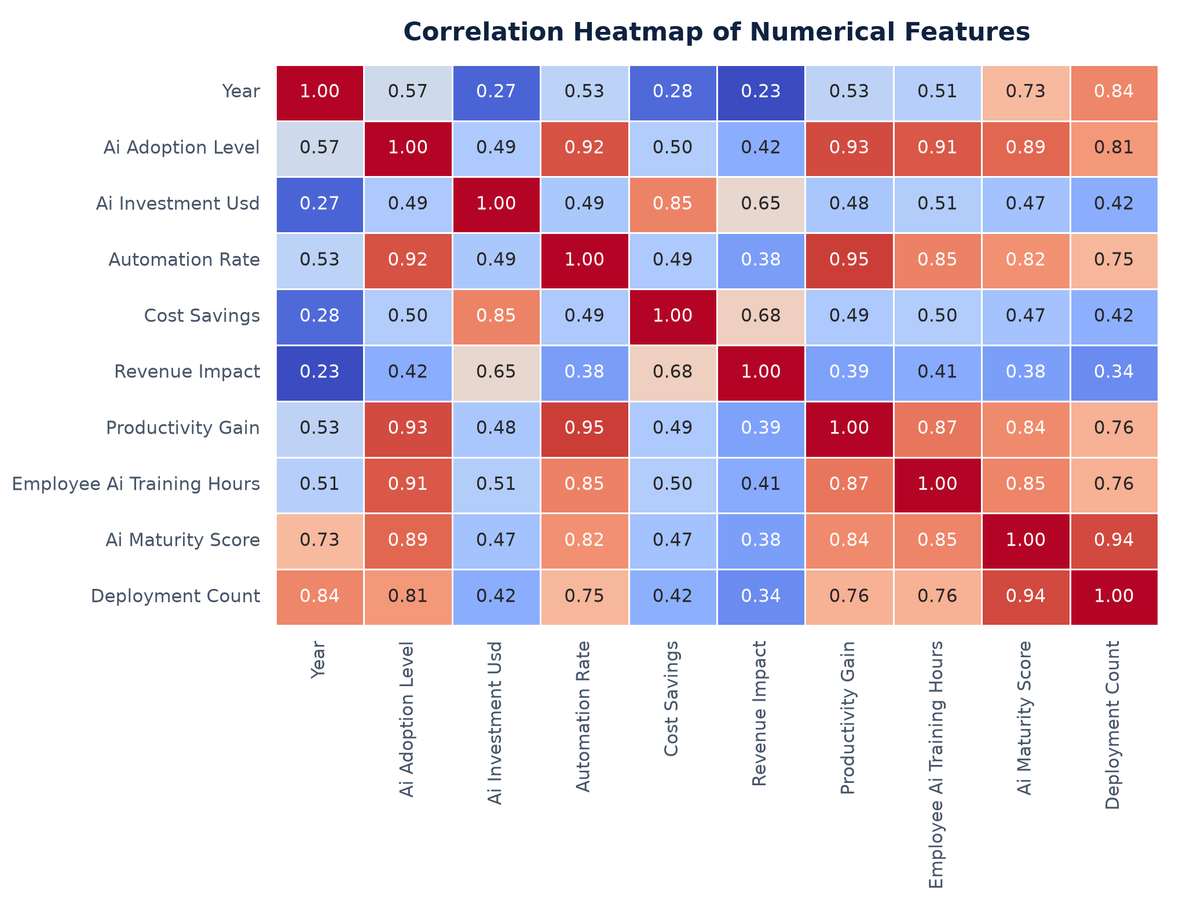
CORRELATION
HEATMAP
Observation
• Automation ↔ Productivity = 0.95
• AI Maturity ↔ Deployment = 0.94
• AI Adoption ↔ Productivity = 0.93
• Training ↔ AI Maturity = 0.85

Slide 12
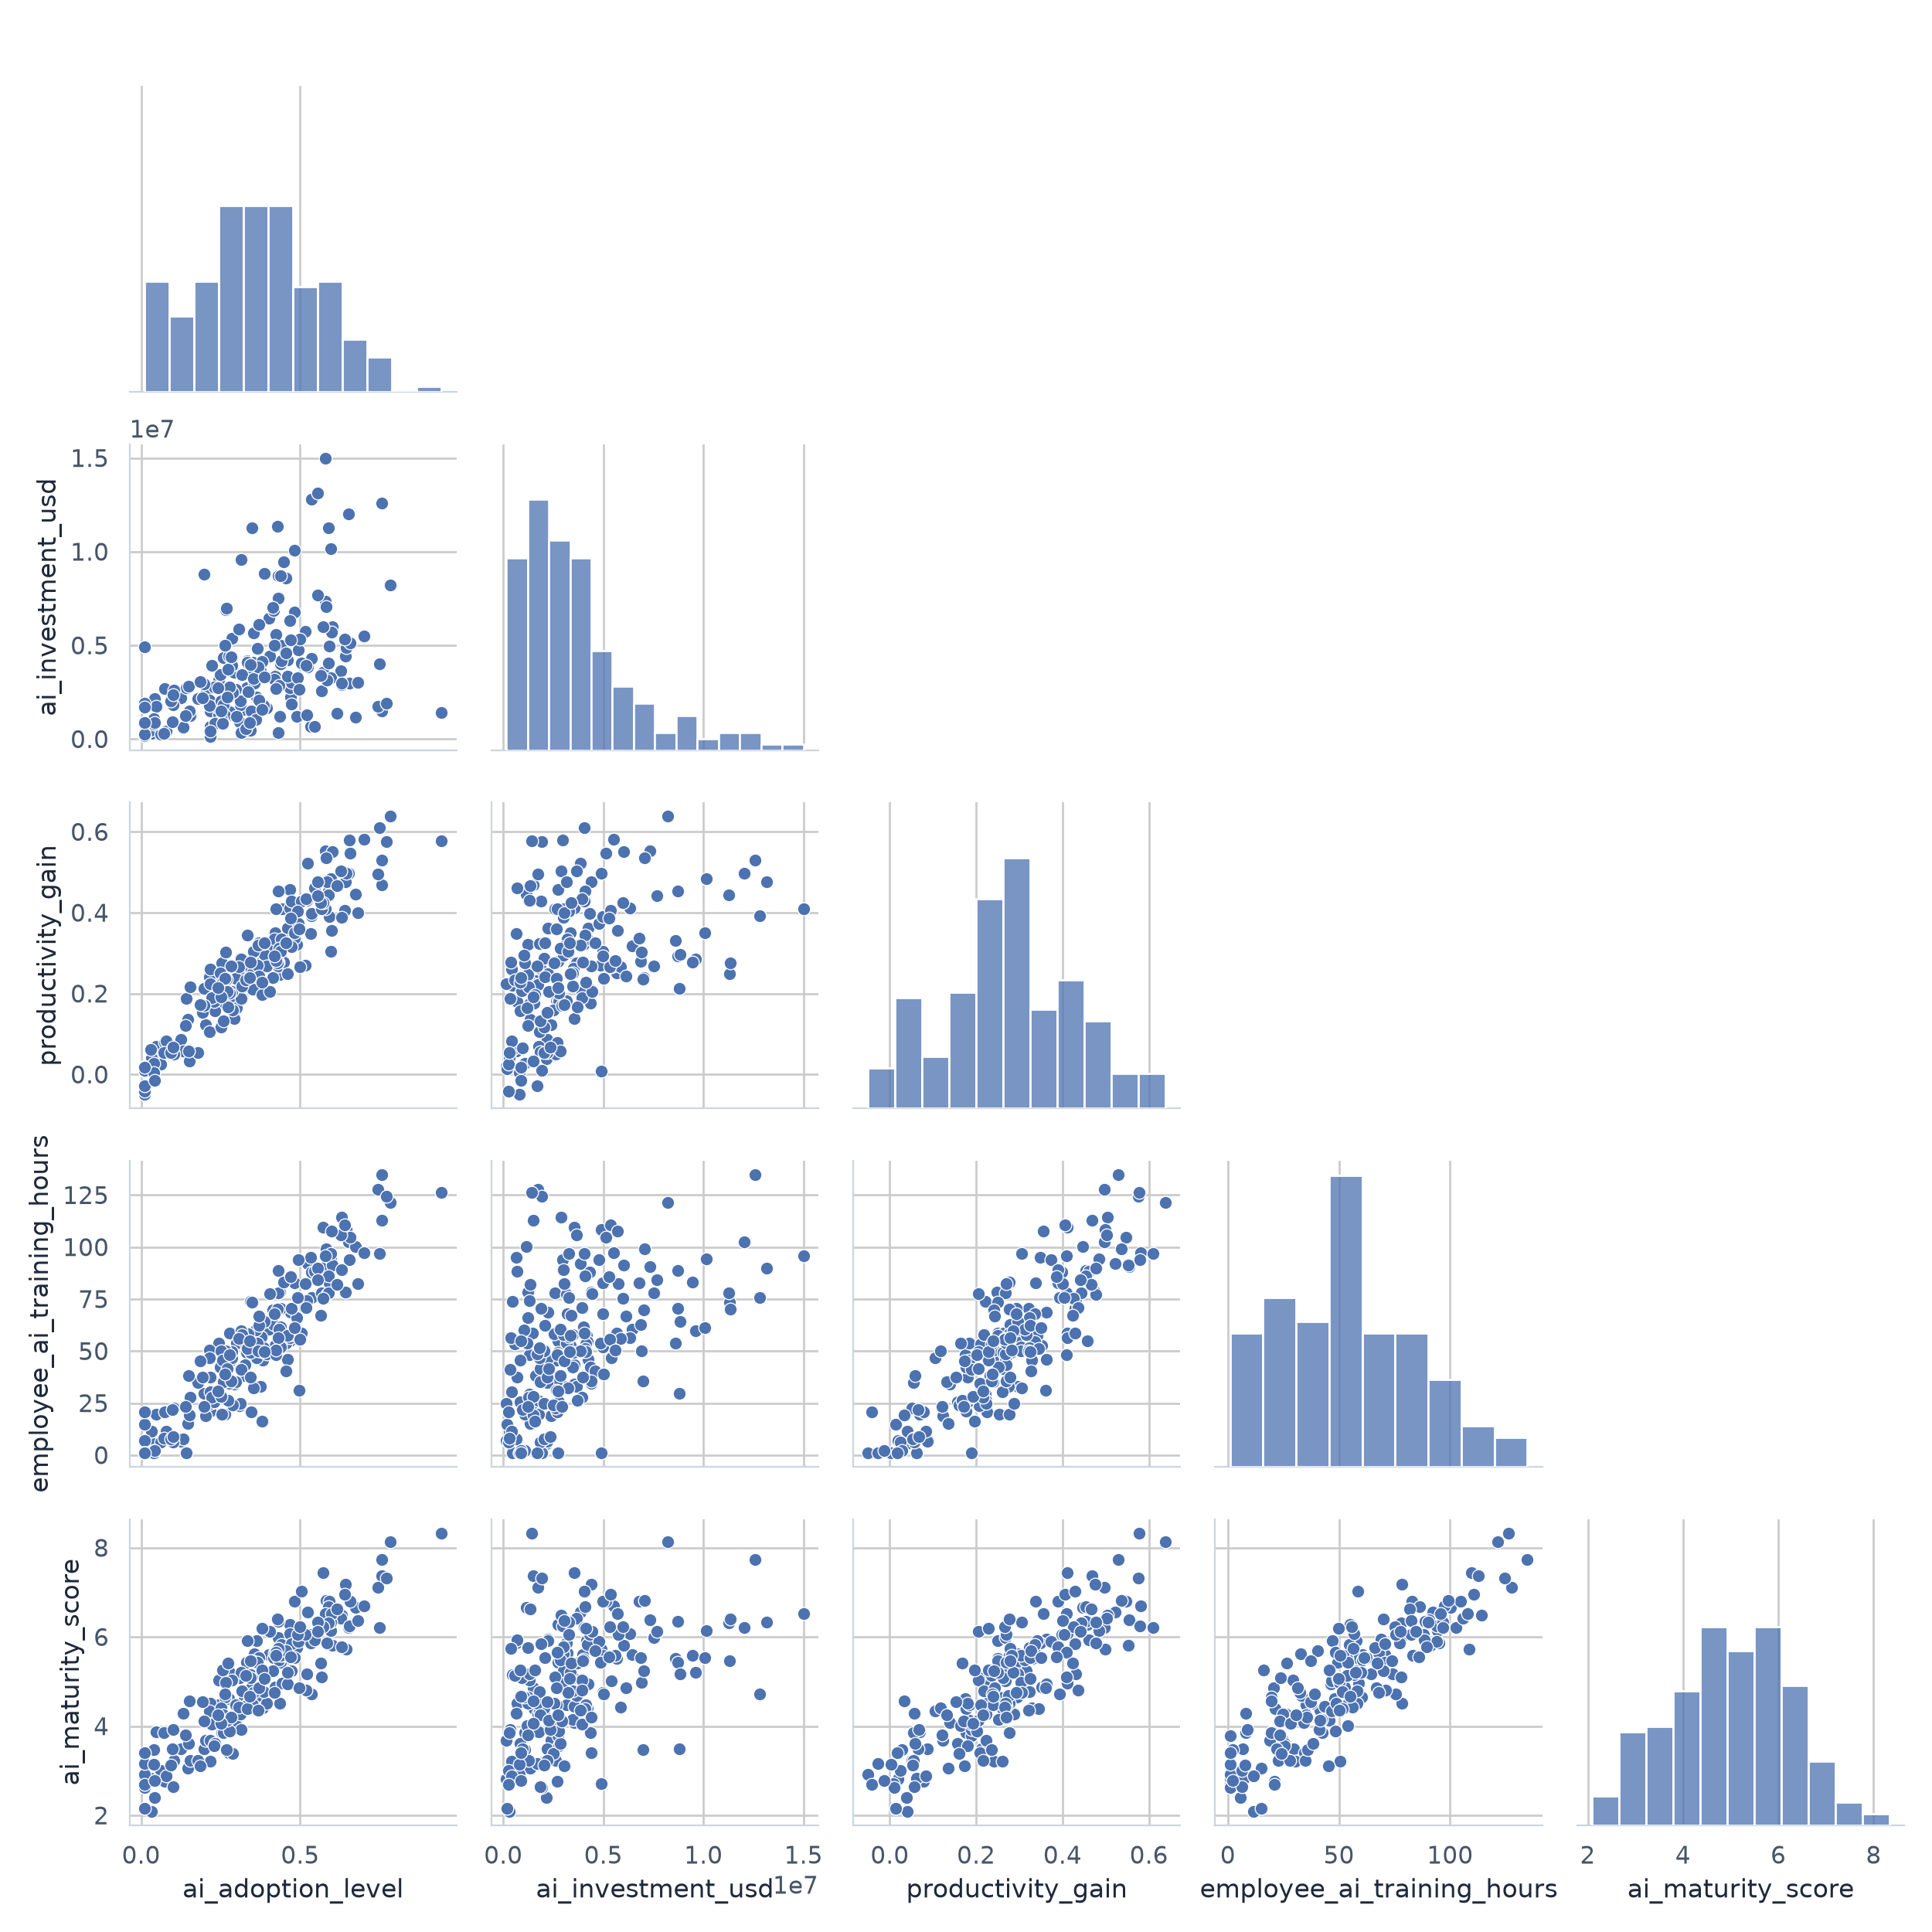
PAIR PLOT
VISUALIZATION
Observation
• Strong positive relationships among major variables.
• AI Investment shows greater variability.
• Employee Training closely aligns with AI Maturity.

Slide 13
KEY
INSIGHTS
📈 AI adoption increased consistently over time.
💰 Financial Services invests the most average budget.
🏭 Manufacturing has the highest productivity gains.
🧑‍🏫 Employee training strongly improves AI maturity.
🤖 Automation rate improves productivity.
💵 Technology generates the highest average revenue.

Slide 14
TOOLS USED IN
DATA ANALYSIS
✔ Increase employee AI training.
✔ Improve AI maturity.
✔ Expand automation.
✔ Invest strategically.
✔ Measure AI performance regularly.
✔ Build long-term AI strategy.
Spreadsheets (Excel, Google Sheets)
Databases (SQL)
BI & Visualization Tools (Power BI, Tableau)
Programming Languages (Python, R)

Slide 15
CONCLUSION
AI adoption has grown consistently between 2015 and 2025, driving significant improvements in productivity, revenue, and cost savings across industries. A balanced strategy that combines financial investment, process-wide automation, and robust employee training is crucial for organizations to maximize their AI returns and build long-term AI maturity.
Thank You

